Slide 1
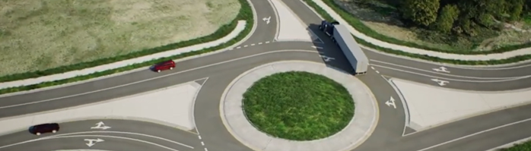
Hwy 10, 29, 71—Wadena Construction
²⁰²⁵⁻²⁰²⁷
Information is tentative and subject to change

Slide 2
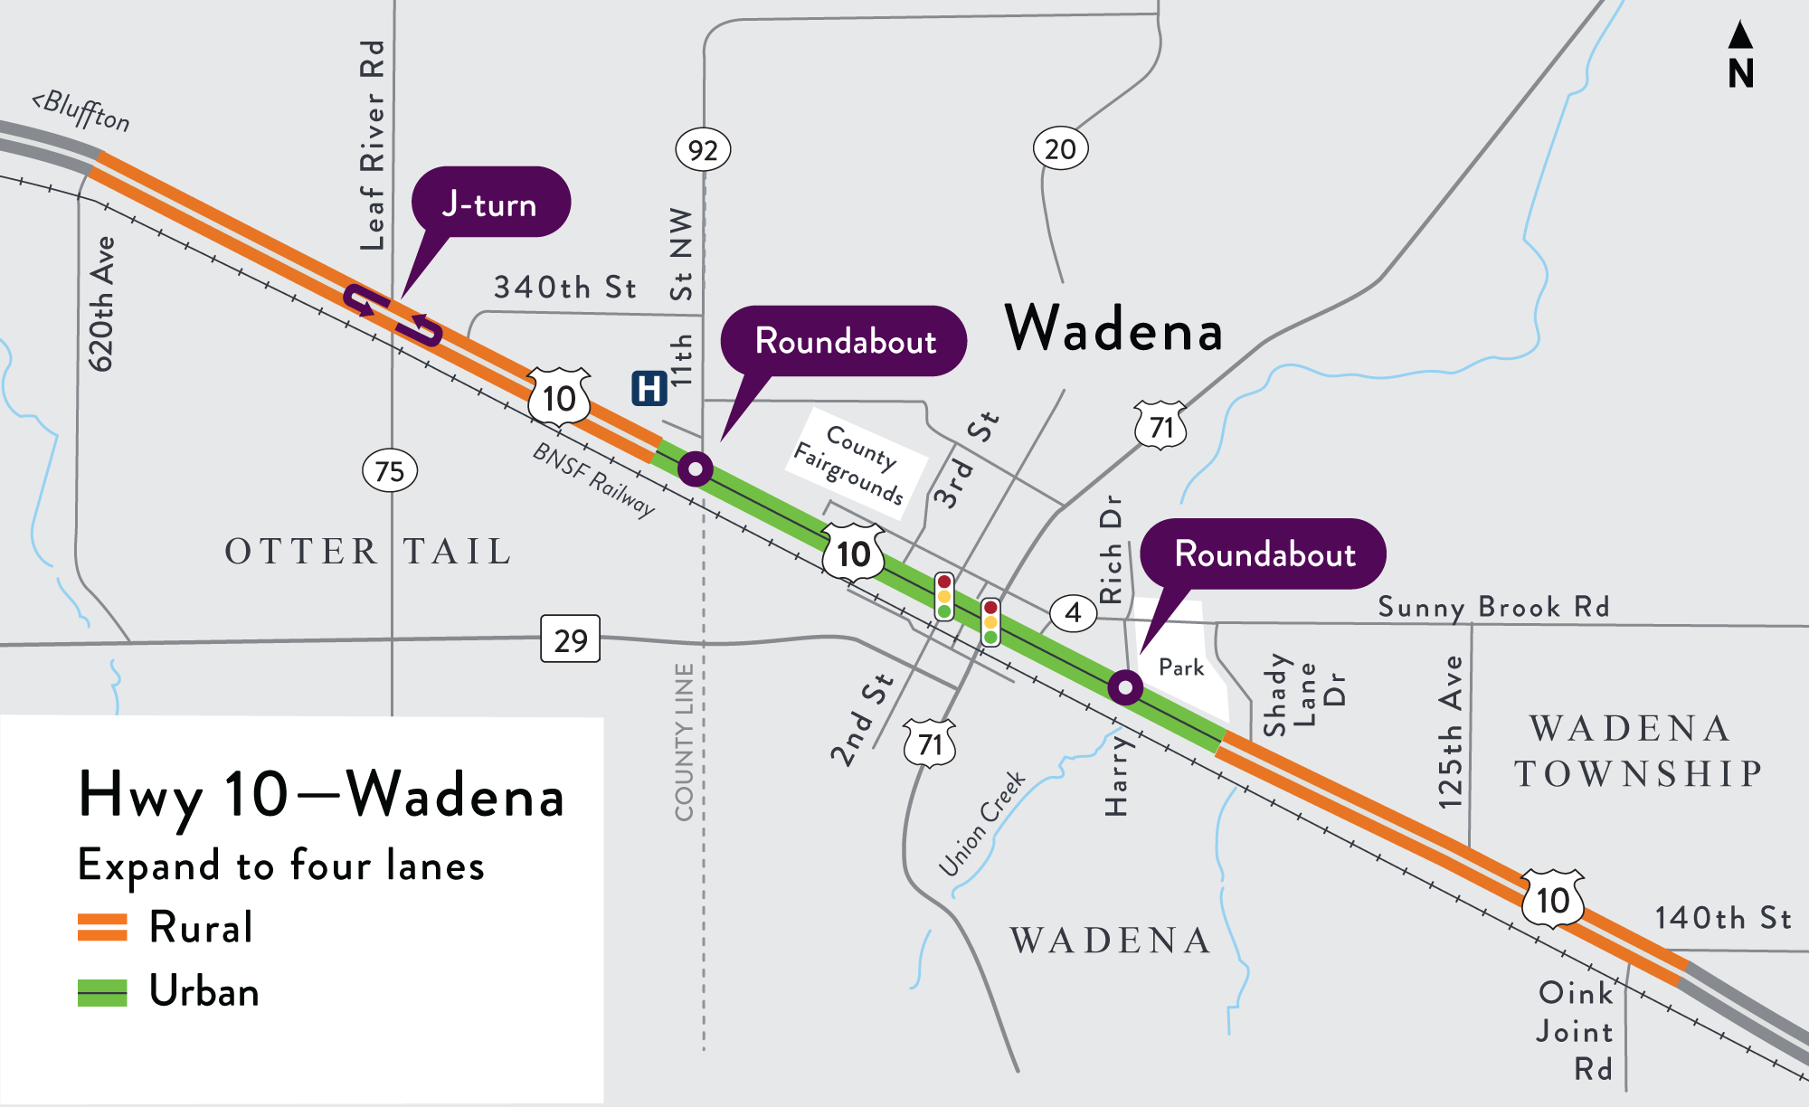
Hwy 10 work—Wadena area
Expand to four lanes, includes adjacent roads and entrances
Construct/add lanes
Install J-turn at Otter Tail CR 75
Construct roundabout by
hospital at Otter Tail CR 92
Construct roundabout at
Harry Rich Dr.
Add turn lane on southbound Hwy 71 to westbound Hwy 10
Install underground structures

Slide 3
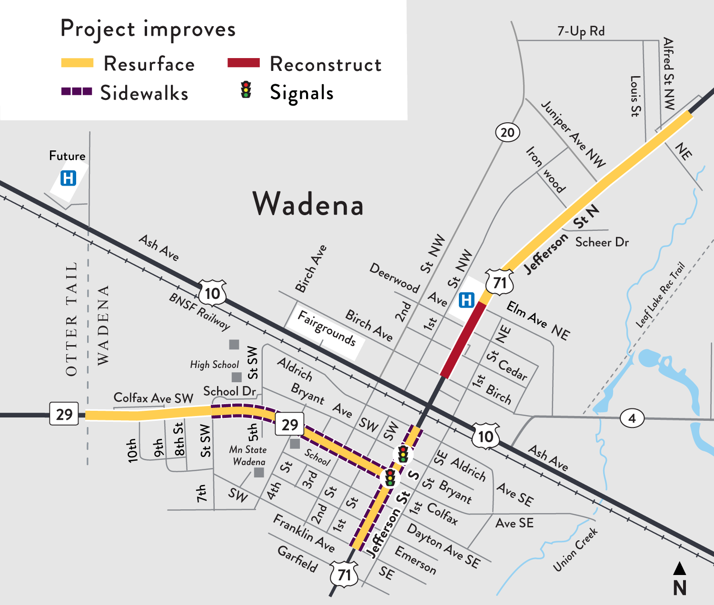
Hwy 29, Hwy 71 work—Wadena
Hwy 71
Reconstruct Birch Ave. N to Elm Ave. N
Underground structures and
city utilities
Update or install sidewalks
Resurface Elm Ave. N to north of Alfred St.
Underground structures
Center left-turn lane to Alfred St.
Sidewalk/trail to Juniper Ave.
Resurface Franklin to Aldrich Ave. S
About six weeks of construction
Sidewalks
Signal systems at Hwy 29, Bryant Ave. S, Aldrich Ave.
Hwy 29
Resurface county line to Hwy 71
About five weeks
of construction
Sidewalks
Underground storm sewers

Slide 4



Work zones
Overall work 2025-2027
Schedules and detours are tentative and all information subject to change by contractor.
Also, weather and material supplies play a
big role on schedule changes.

Slide 5
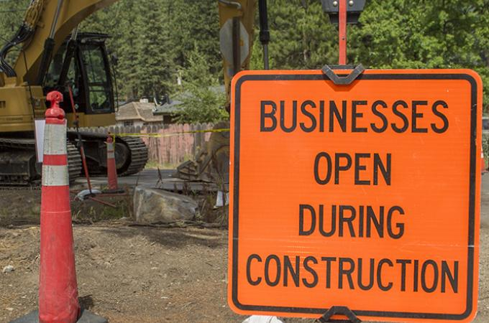
Wadena is open for business
Access for those who live, work and visit areas along the project will be maintained and open
May use a side street, alley or back or
side entrance
May be gravel surface
Start planning alternatives for you and your customers
MnDOT will have a business contact available to businesses and residents along the project once construction begins

Slide 6

Prep-work—In progress
Now until start
Periodic lane, shoulder closures or flaggers controlling traffic as crews prepare work areas
  Now until June: Relocating utilities
  February to mid-April: Tree and area clearing along the project—building demo
  May-June: Temporary work like crossovers on Hwy 10
All traffic impacts are tentative and weather dependent
Current impacts, check www.511mn.org

Slide 7
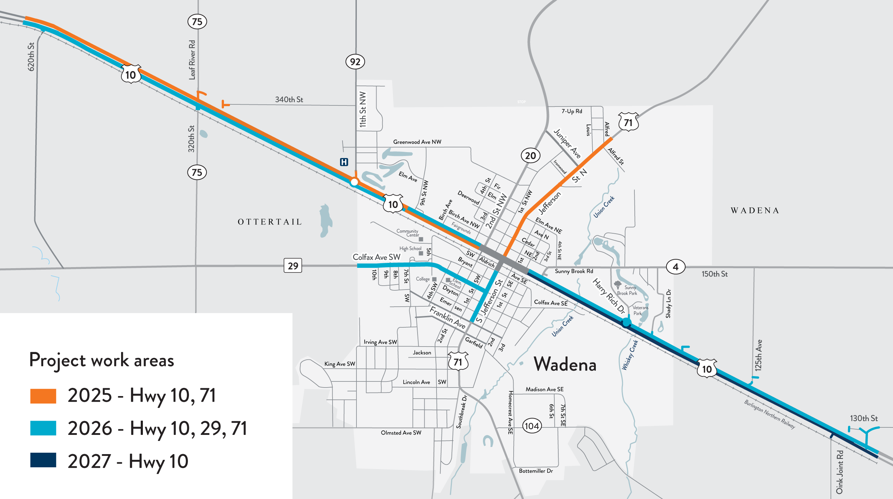
Project work areas by year—2025, 2026 and 2027

Slide 8
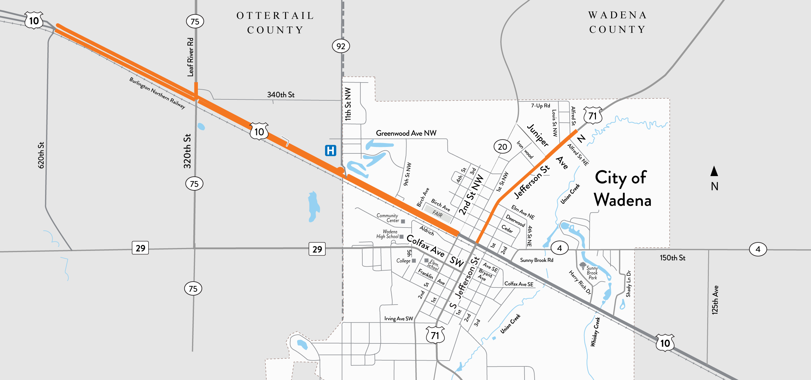
2025 work zone
Construct north
CR 75 access and
half of J-turn
Construct half of roundabout
Complete north Hwy 71 work
Complete first half of new four lane
Replace poor soils between CR 92 and 9th St. and
install drainage pipes
2025 work

Slide 9
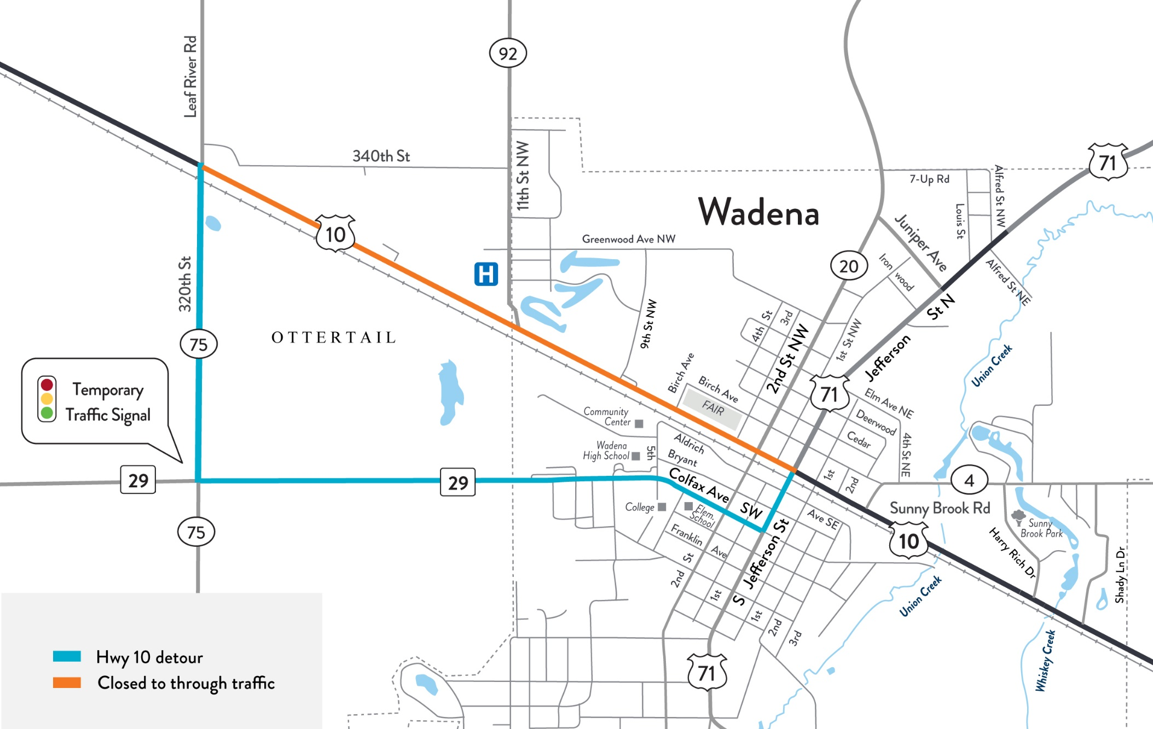
Hwy 10 detour in 2025—Wadena
Full width of road
west of 9th St
Detour about eight weeks
Roundabout
Replace bad soils fairgrounds to roundabout

Slide 10
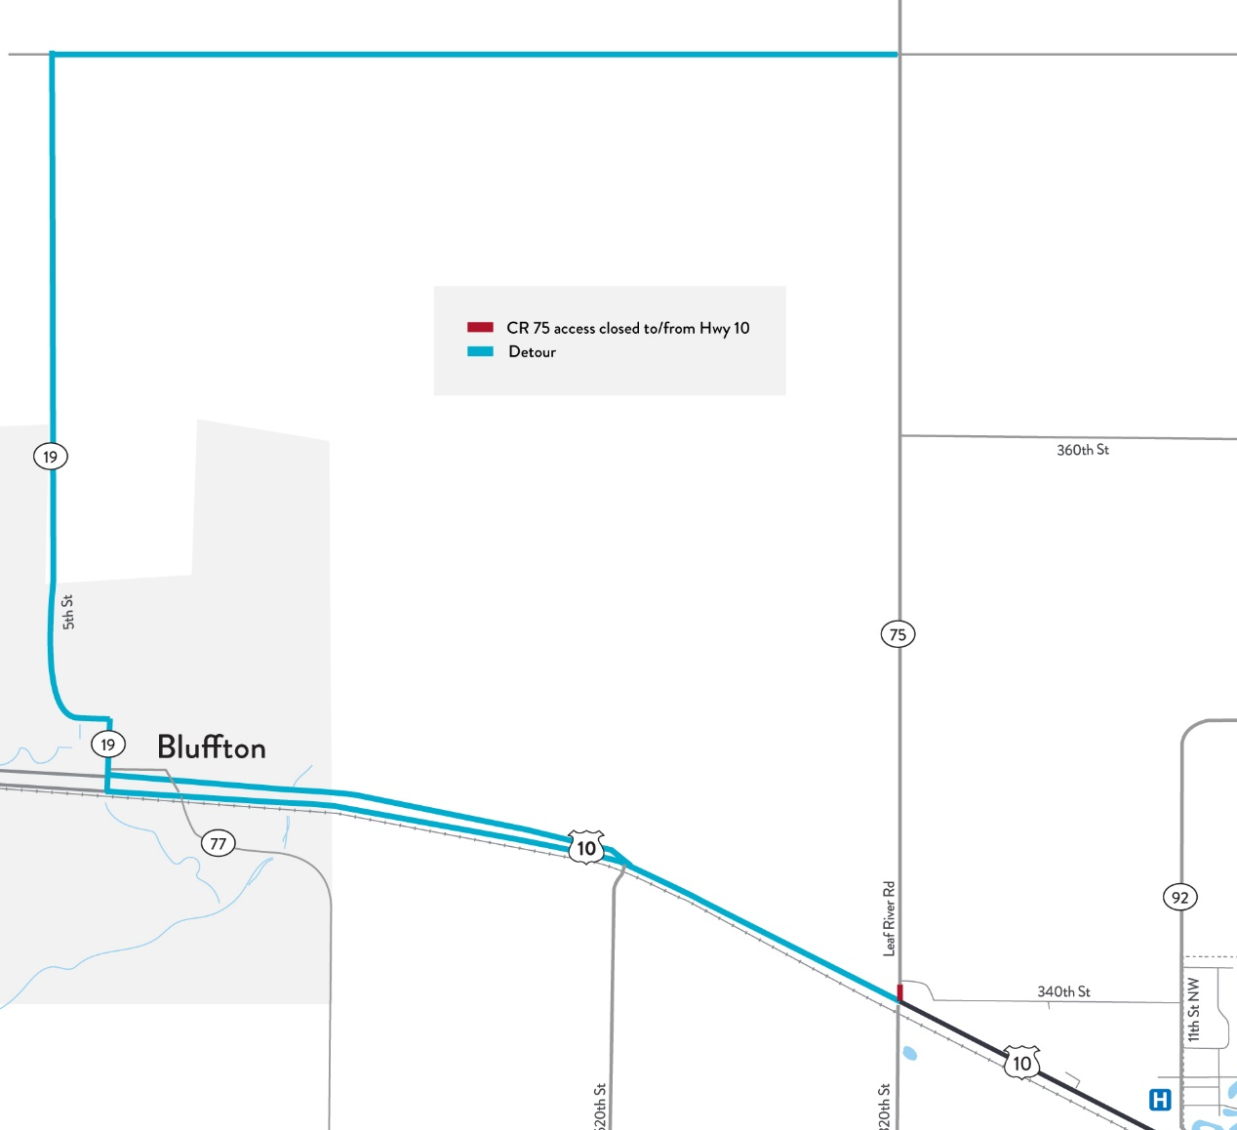
CR 75 detour north of Hwy 10 in 2025—west of Wadena
CR 76
Work
Reconstruct CR 75 north
access connection
Detour (about three weeks)
Hwy 10, CR 19 Bluffton, CR 76
CR 75
CR 19

Slide 11
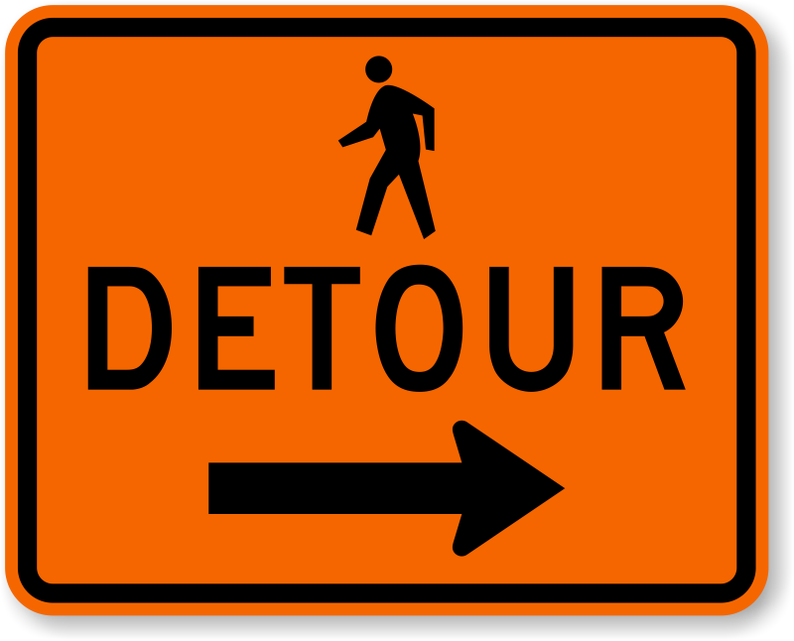
Pedestrian access
Pedestrian sidewalks will close during reconstruction, follow signs
For your safety, please stay out of closed areas
Crews will work on one side
of road/sidewalk at a time

Slide 12
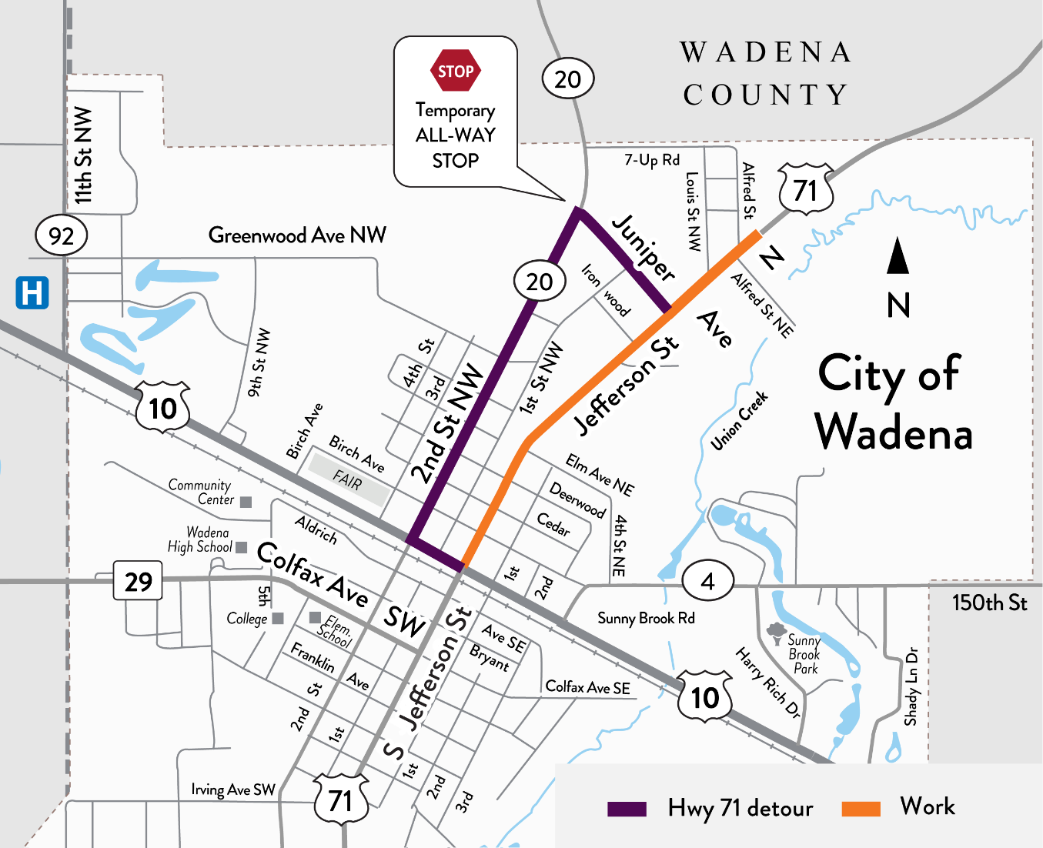
Hwy 71 detour in 2025—Wadena
Work
Underground utilities
Remove old hospital pedestrian tunnel
Detour (about seven weeks)
Hwy 10, CR 20 and
Juniper Ave.
Temp all-way stop at CR 20 and Juniper Ave.

Slide 13
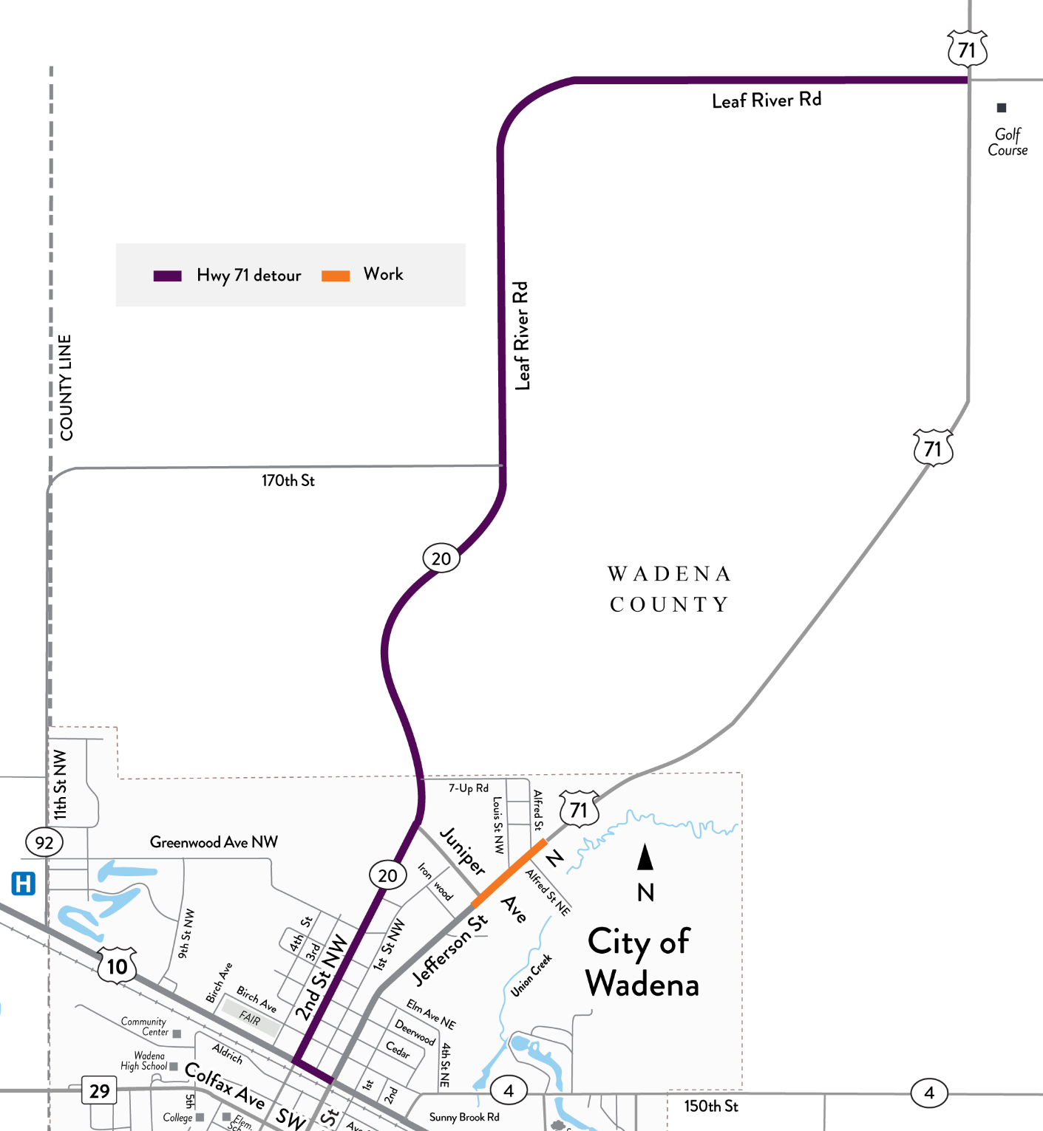
Hwy 71 detour extends north of Wadena—2025
Work
Underground storm pipes and shoulder reconstruction.
Detour (about 6-7 weeks)
Hwy 10, CR 20 and Leaf River Rd.

Slide 14
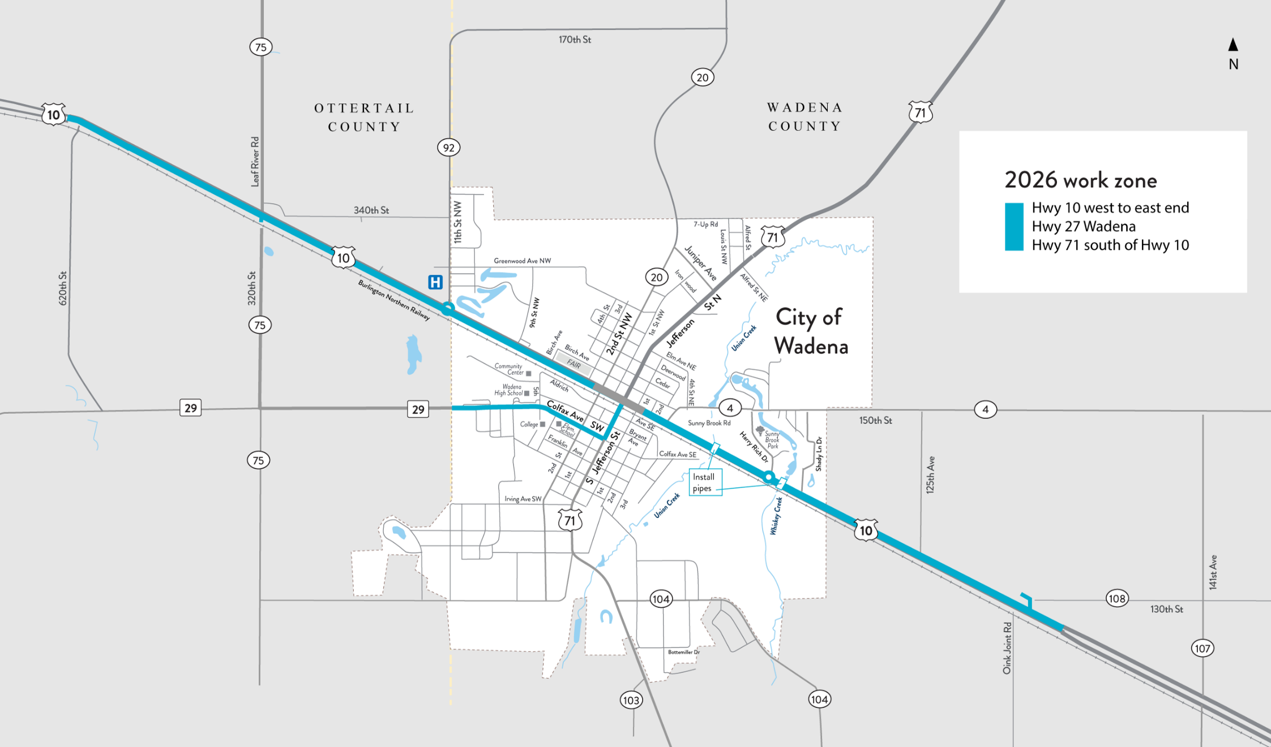
2026 work zone
Complete four lane to CR 20
Complete roundabout
Construct south CR 75 access and
complete J-turn
Complete all Hwy 29 work
Complete first half of four lane
Complete all south Hwy 71 work
Replace poor soils, install both creek pipes and construct half of roundabout

Slide 15
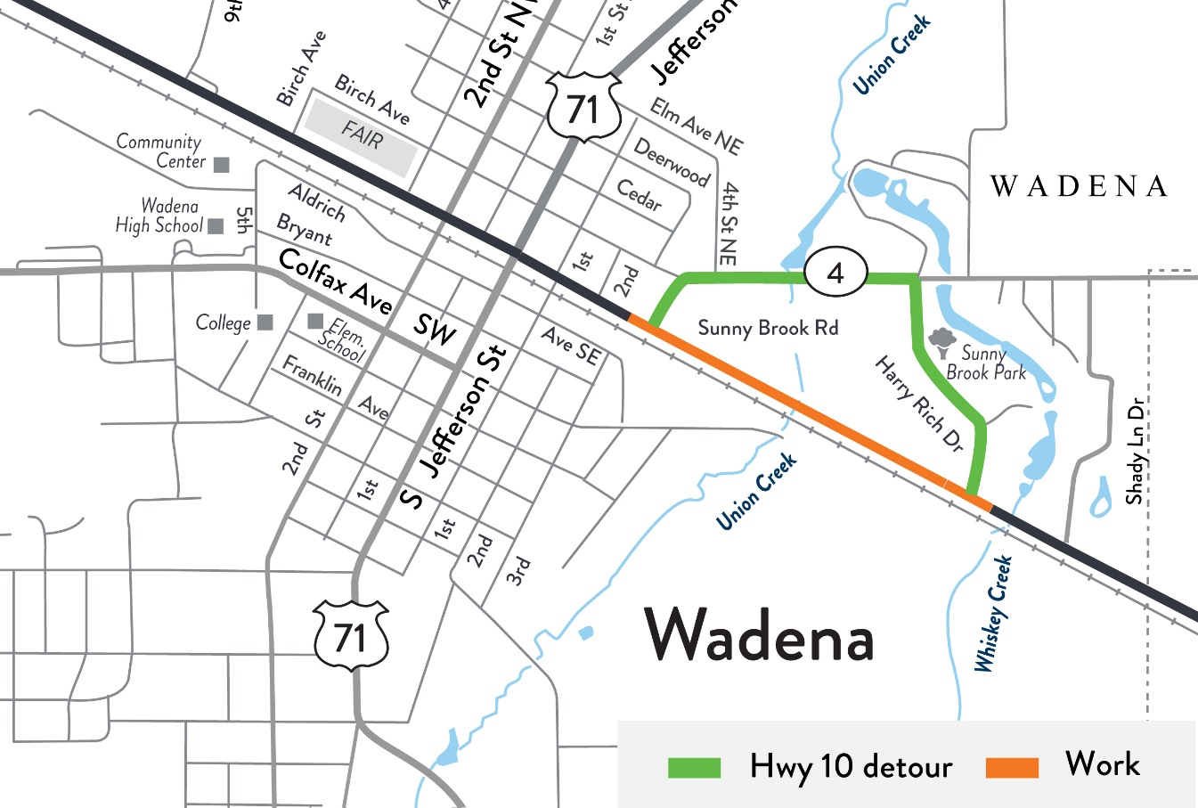
Hwy 10 detour in 2026—Wadena
Work
Excavate and replace bad soils
Replace Union Creek pipe
Detour (about five weeks)
Wadena CR 4 and Harry Rich Dr.
Union Creek box bridge
Excavate/replace bad soils

Slide 16
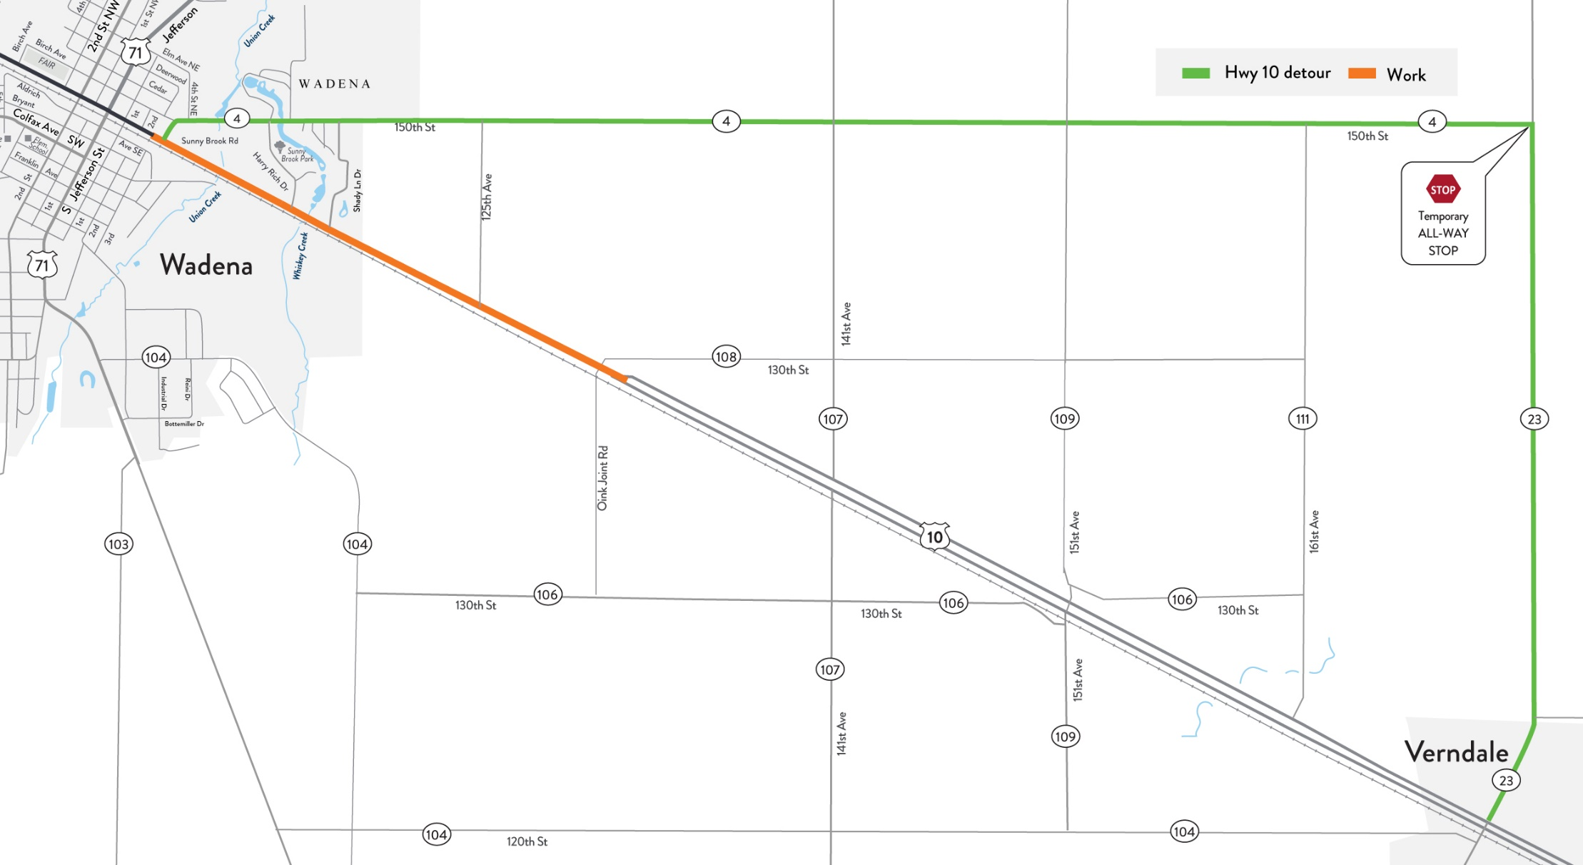
Hwy 10 detour in 2026—east Wadena to Verndale
Detour
(about six weeks)
CR 4, CR 23
Locals to use side streets east/west of closure
Close to excavate deep to replace soils
Half of roundabout
Locals to use side streets east/west of closure
Replace Whiskey Creek bridge

Slide 17
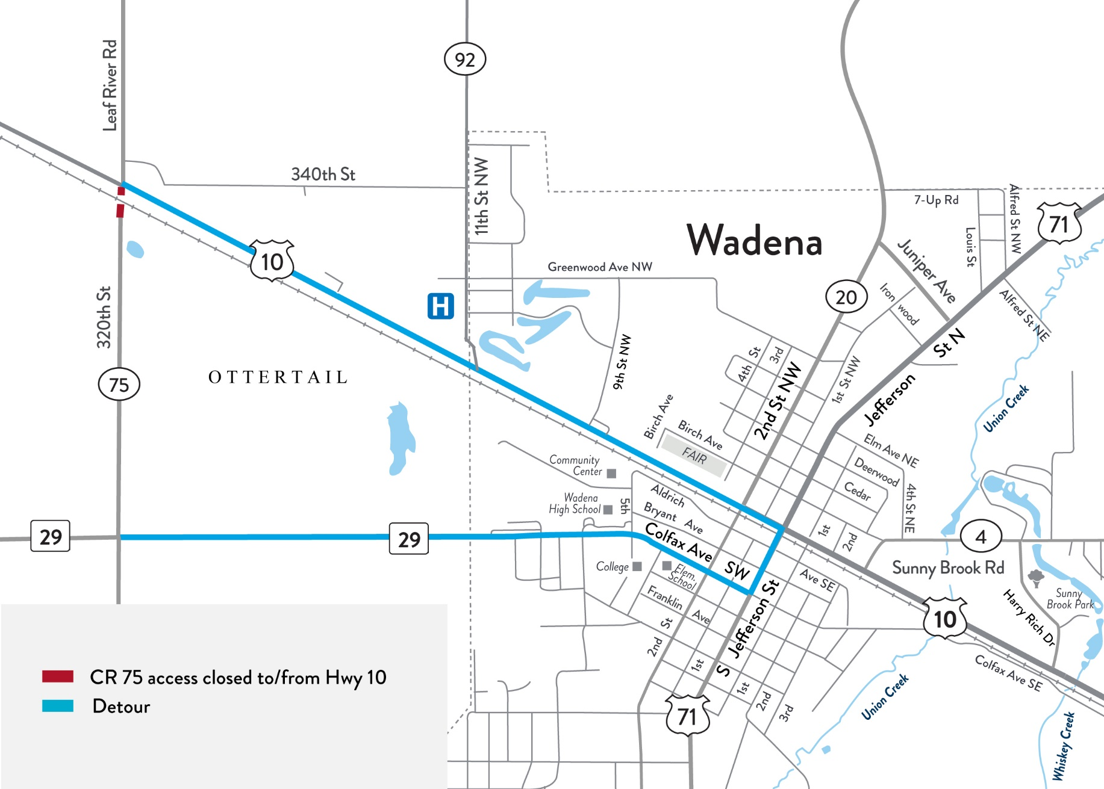
CR 75 detour south of Hwy 10 in 2026—west of Wadena
Work
Reconstruct CR 75 south connection to/from Hwy 10 and complete J-turn
Detour
(about three weeks)
Hwy 29, Hwy 71 Wadena and Hwy 10

Slide 18
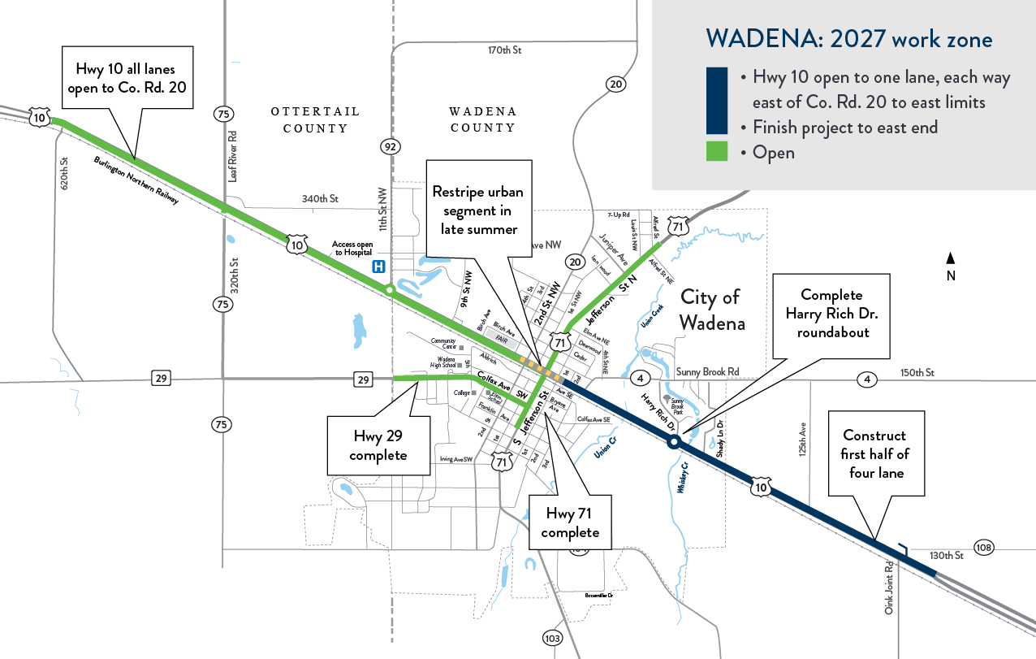
2027 work zone
Complete
four-lane by late summer

Slide 19



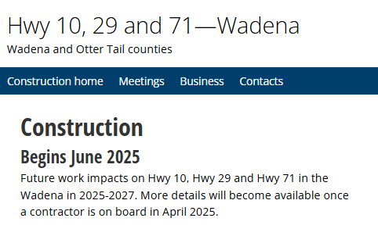

Stay connected: Wadena construction
Bookmark web page for
current impacts and work
Sign up for Wadena construction updates
Scan QR Code
www.mndot.gov/d3/projects/Wadena

Slide 20


MnDOT construction project contacts
Jody Mies
Construction Project Manager
Jody.Mies@state.mn.us
218-821-3292
LeAnn Goltz
Communications Project Manager
leann.goltz@state.mn.us
218-232-6753
www.mndot.gov/d3/projects/Wadena/

Slide 21

Thank you!
Wadena Construction 2025-2027
www.mndot.gov/d3/projects/wadena

